Slide 1
Code design principals
Why it is needed
OOP principals
DRY
SOLID
Coupling
Cohesion
Design patterns
Code and configuration
Fail fast and fail safe
Best practices list
Code style conventions

Slide 2
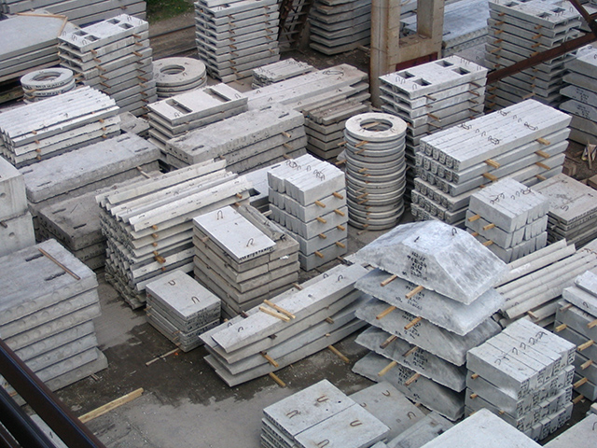
Why do we need design principals
Almost all tasks has already been solved and have a solution

Slide 3
OOP
Abstraction
Encapsulation
Inheritance
Polymorphism

Slide 4
Abstraction
Abstraction is the act of representing essential features without including the background details or explanations

Slide 5

Abstraction
Product
Model
Code
ShelfId
Enum ShelfId
BspSwitchBlade
Interface BspSwitchBlade
BridgeId
Class SwitchBlade100
Class SwitchBladeSMX
ECIM
Ecim API library

Slide 6
Encapsulation
It refers to the bundling of data with the methods that operate on that data. Encapsulation is used to hide the values or state of a structured data object inside a class, preventing unauthorized parties' direct access to them. Publicly accessible methods are generally provided in the class (so-called getters and setters) to access the values, and other client classes call these methods to retrieve and modify the values within the object.

Slide 7
Inheritance
Inheritance in Java is a mechanism in which one object acquires all the properties and behaviors of a parent object.
Represents IS-A class relation
Examples: Truck is a car, but motorbike is not a car
Aggregation represents HAS-A relation, but the object exists outside the other, is created outside, so it is passed somehow inside.
Examples: Car has an engine and motorbike has an engine
Composition represents HAS-A relation, the object only exists, or only makes sense inside the other, as a part of the other.
Examples: Fuel truck has a tank, it makes no sense without it.

Slide 8
Polymorphism
Polymorphism is the ability of an object to take on many forms
Represents IS-A class relation
Dynamic(late) binding
public class DynamicBindingTest { public static void main(String args[]) { Vehicle = new Car(); //here Type is vehicle but object will be Car vehicle.start(); //Car's start called because start() is overridden method } } class Vehicle { public void start() { System.out.println("Inside start method of Vehicle"); } } class Car extends Vehicle { @Override public void start() { System.out.println("Inside start method of Car"); } }

Slide 9
Do not repeat yourself
Code duplication
If you find a bug in your copy-paste code, you will need to fix it every place you did and hope you can remember them all (this also holds for changed requirements).
If you keep logic in one place, it is easier to change when needed (so if you decide that the application needs updating, you only do it in one place).
Golden rule: Before writing anything check whether it is already written and if it is reuse
https://www.artima.com/intv/dry.html
https://en.wikipedia.org/wiki/Duplicate_code

Slide 10
SOLID principals
SOLID is one of the most popular sets of design principles in object-oriented software development. It’s a mnemonic acronym for the following five design principles:
Single Responsibility Principle
Open/Closed Principle
Liskov Substitution Principle
Interface Segregation Principle
Dependency Inversion
https://en.wikipedia.org/wiki/SOLID

Slide 11
Single Responsibility Principle
A class should have one, and only one, reason to change.

Slide 12
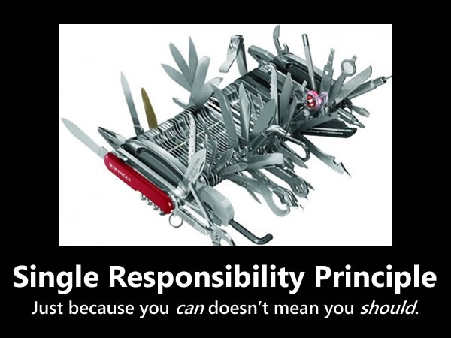

Slide 13
Open close principal
Software components should be open for extension, but closed for modification

Slide 14
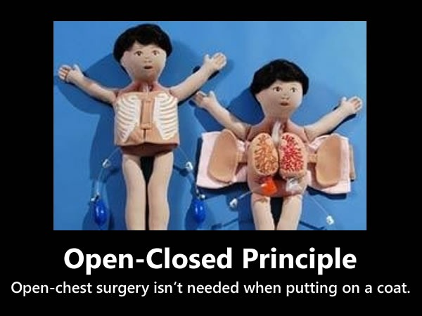

Slide 15
Liskov’s substitution principal
Methods that use references to the base classes must be able to use the objects of the derived classes without knowing it

Slide 16
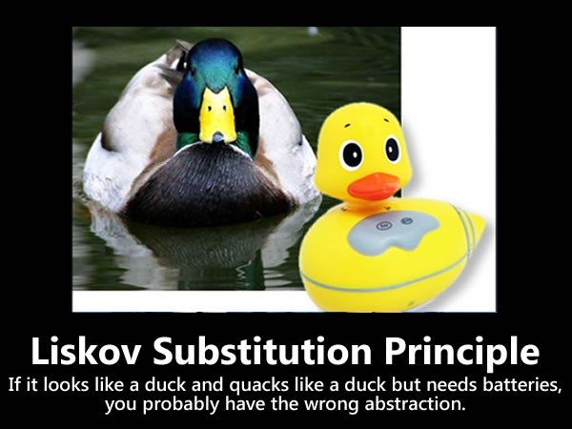

Slide 17
Interface segregation principal
Many client specific interfaces are better than one general purpose interface

Slide 18
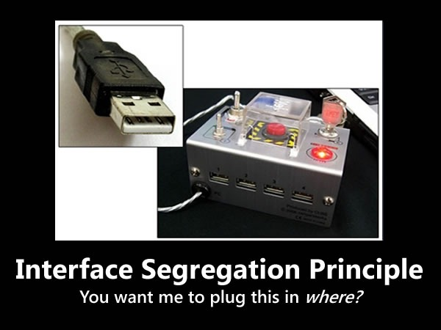

Slide 19
Dependency inversion
High-level modules should not depend on low-level modules. Both should depend on abstractions.
Abstractions should not depend on details. Details should depend on abstractions.

Slide 20


Slide 21
Coupling
Coupling refers to the extent to which a class knows about the other class
There are two types of coupling -
Tight Coupling(a bad programming design)
Loose Coupling(a good programming design)

Slide 22
Cohesion
Cohesion refers to the extent to which a class is defined to do a specific specialized task. A class created with high cohesion is targeted towards a single specific purpose, rather than performing many different specific purposes.
There are two types of cohesion -
Low cohesion(a bad programming design)
High Cohesion(a good programming design)

Slide 23
Cohesion
Law of Demeter
The Law of Demeter (LoD) or the principle of least knowledge is a object-oriented software design principle. In its general form, the LoD is a specific case of loose coupling.
The formal object form of the law can be summarized as:
A method of an object may only call methods of:
The object itself.
An argument of the method.
Any object created within the method.
Any direct properties/fields of the object.

Slide 24
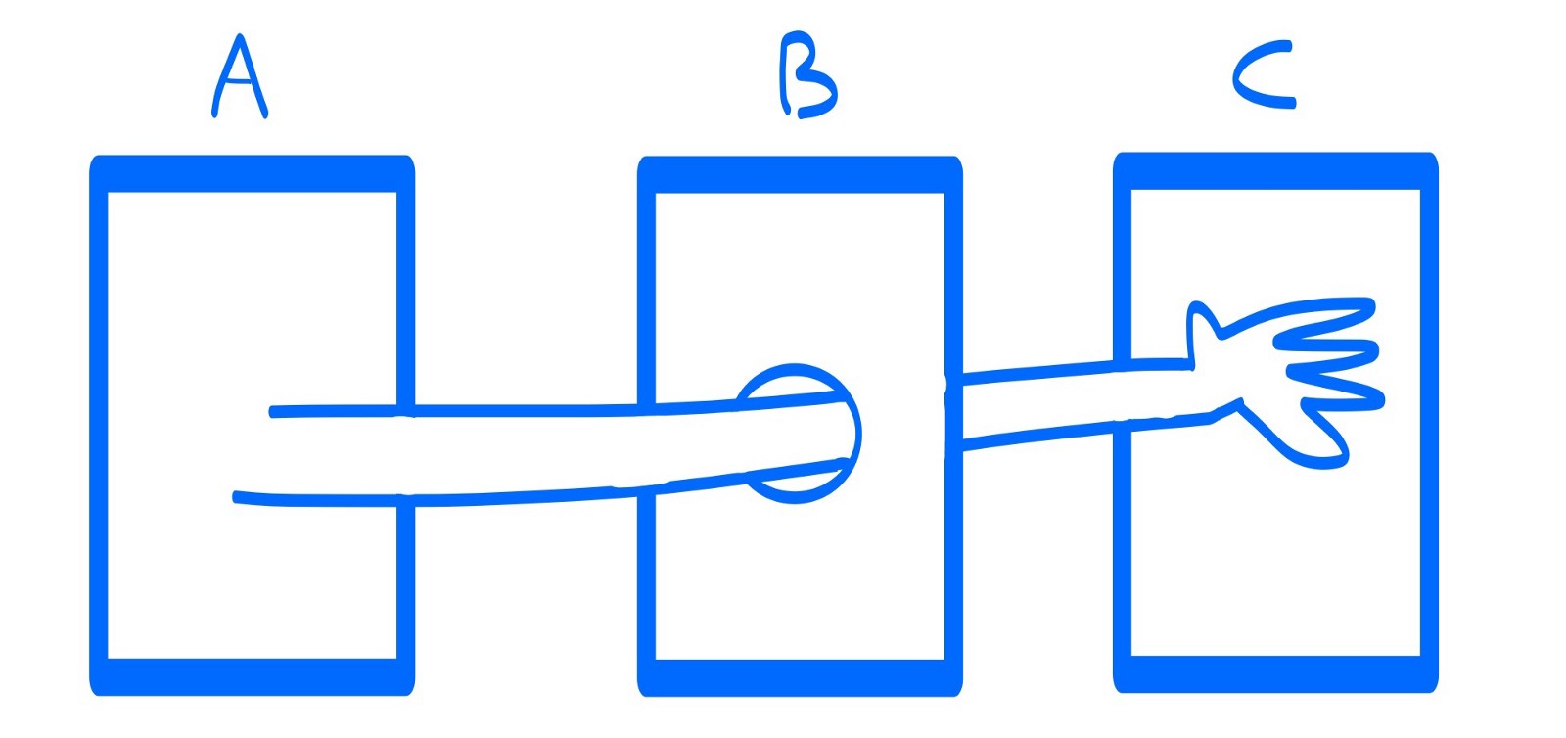
Cohesion
Law of Demeter
The Law of Demeter (LoD) or the principle of least knowledge is a object-oriented software design principle. In its general form, the LoD is a specific case of loose coupling.
The formal object form of the law can be summarized as:
A method of an object may only call methods of:
The object itself.
An argument of the method.
Any object created within the method.
Any direct properties/fields of the object.

Slide 25
Design patterns
Software design pattern is a general, reusable solution to a commonly occurring problem within a given context in software design. It is not a finished design that can be transformed directly into source or machine code. It is a description or template for how to solve a problem that can be used in many different situations. Design patterns are formalized best practices that the programmer can use to solve common problems when designing an application or system.

Slide 26
Singleton
The singleton pattern is a software design pattern that restricts the instantiation of a class to one object. This is useful when exactly one object is needed to coordinate actions across the system.

Slide 27
Builder
The Builder is a design pattern designed to provide a flexible solution to various object creation problems in object-oriented programming. The intent of the Builder design pattern is to separate the construction of a complex object from its representation.

Slide 28
Factory
Factory design pattern is used when we have a super class with multiple sub-classes and based on input, we need to return one of the sub-class. This pattern take out the responsibility of instantiation of a class from client program to the factory class.

Slide 29
Strategy
The strategy pattern enables selecting an algorithm at runtime

Slide 30
Code and configuration
Business logic, cross functions and configuration have never to be mixed.
Test has only business logic – verification
All cross functions and utilities are moved out from the test
All configuration comes from external source(SUT or file) and must never been hardcoded

Slide 31
Fail fast and fail safe
A fail-fast system is one which immediately reports at its interface any condition that is likely to indicate a failure. Fail-fast systems are usually designed to stop normal operation rather than attempt to continue a possibly flawed process.
A fail safe system is expected to eventually fail but when it does it will be in a safe way.

Slide 32
Best practice list
Minimise accessability
Prefer immutable classes
Prefer composition to inheritance
Do not use row type
Do not use arrays
Always use enum whenever you have limited value scope. Never use String in such cases
Validate parameters
When declare variable or parameter use interfaces instead of specific class
Always close resources safely
Do not use deprecated methods
Do not hardcode configuration
Use static import for frequently used utility class methods and constants
Always log caught exceptions
Reduce I/O operations number
Avoid low level optimizations

Slide 33
Summary specific for tests
Test specification is not a document that defines code architecture
General rule: if two tests do the same actions but with different parameters and expectations – they are one test
Do not split set-check-remove
Avoid inheritance
Keep your tests short and simple
Do not hardcode configuration
Use full power of test execution engine and JCAT lifecycle control to minimize test execution time
Always close resources safely
Keep your tests up do date, refactor it to use modern features to improve stability and reduce maintenance costs

Slide 34
JCC
Why Have Code Conventions
Code conventions are important to programmers for a number of reasons:
80% of the lifetime cost of a piece of software goes to maintenance.
The general formatter makes code to look similar, so it is easy to read it and maintain.
In some cases it may also prevent stupid mistakes
If you ship your source code as a product, you need to make sure it is as well packaged and clean as any other product you create.
http://www.oracle.com/technetwork/java/codeconvtoc-136057.html
In order to ensure JCC is followed maven code and java doc formatter plugins are used. Use them to format your code locally before submit.

Slide 35
Static code analysis and XML
In order to prevent stupid mistakes static code analysis systems like sonar are used.
Use eclipse sonar plugin to validate your code locally
There is no any common XML code formatter, so you have to ensure everybody within the project have the same eclipse XML formatter plugin settings .
Use XML eclipse plugin to validate single fine or maven clean install to trigger XML validation plugin for entire project
Note: To disable XML validation during maven build actions use VM arg:
-Debs.xml.disableXmlValidate

